Slide 1
Introduction to Robotics
CSE461
BRAC University

Slide 2
Reference Books
Introduction to AI robotics by Murphy, Robin
Intelligent systems and robotics by George W. Zobrist and C.Y. Ho.
Springer Handbook of Robotics by Bruno Siciliano, Oussama Khatib
Robotics, Vision and Control: Fundamental Algorithms In MATLAB, Second Edition by Peter Corke
Modern Robotics: Mechanics, Planning, and Control by Kevin M. Lynch
Probabilistic Robotics by Sebastian Thrun, Wolfram Burgard, Dieter Fox
Introduction to Robotics by S K Saha
Robotics: Control, Sensing, Vision, and Intelligence by K S Fu, Rafael C. Gonzalez, C S G Lee

Slide 3
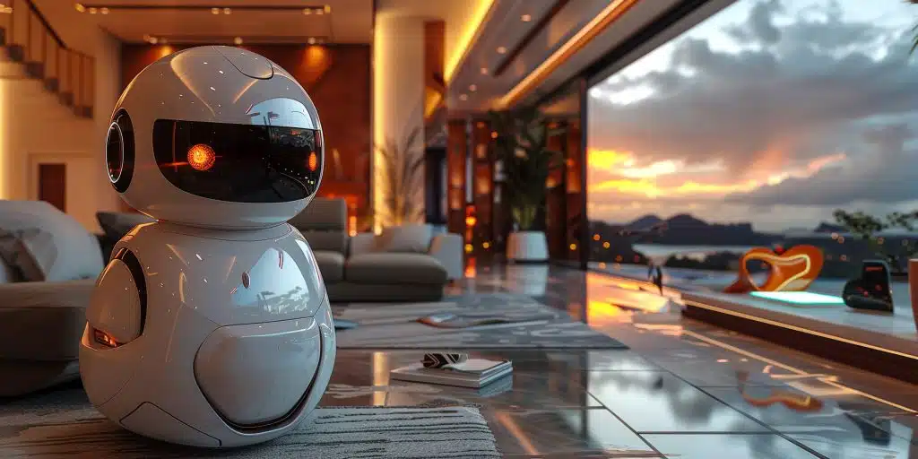
What is a robot?
An embodied agent that can be programmed to perform physical tasks.

Slide 4
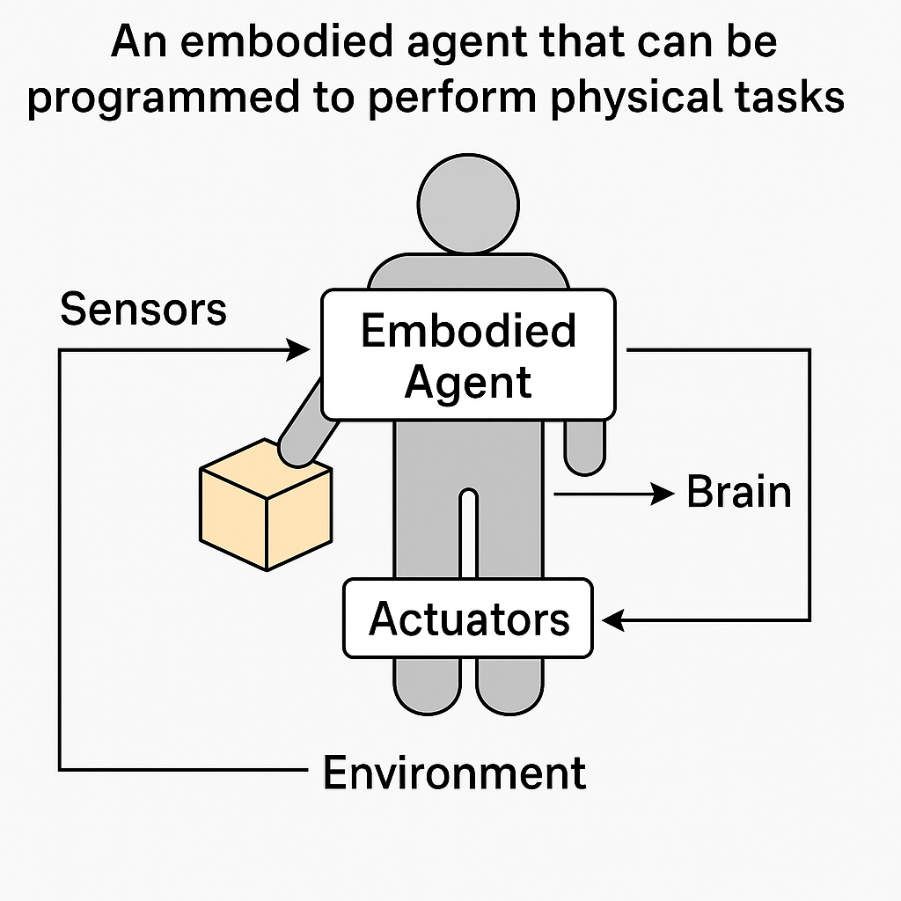

Slide 5
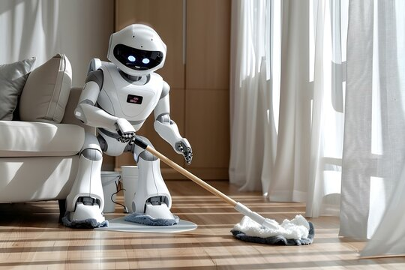

Slide 6


Slide 7
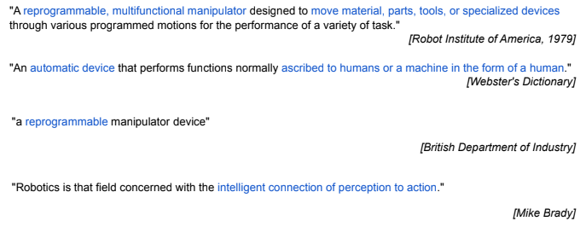
What is Robot?

Slide 8
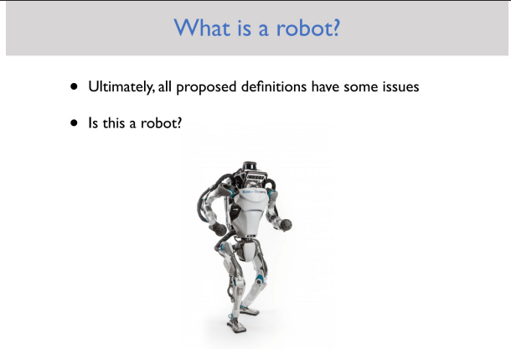

Slide 9
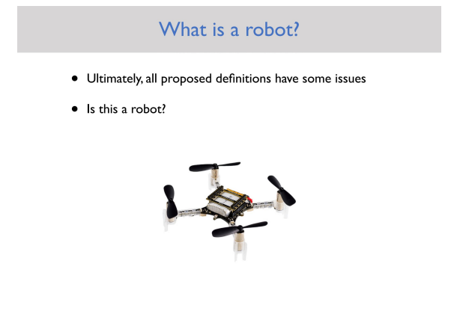

Slide 10
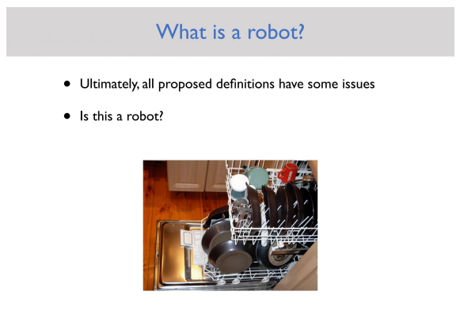

Slide 11
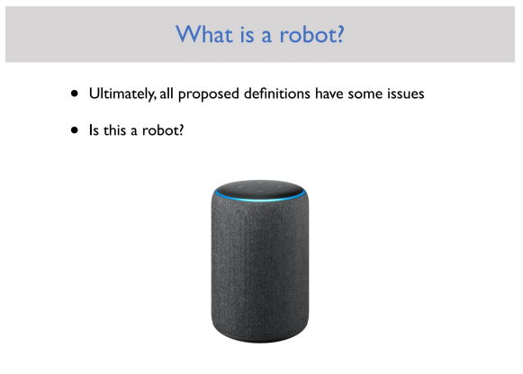

Slide 12
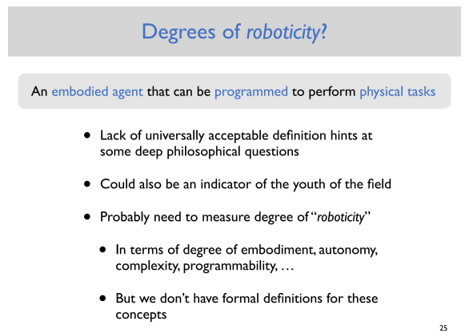

Slide 13
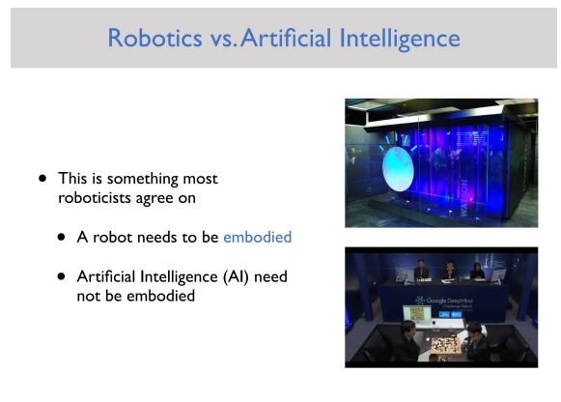

Slide 14
Objective of Robotics
Industry Automation
Smart, IoT and Embedded Systems
Efficient task specific Robot
4th Industrial Revolution

Slide 15
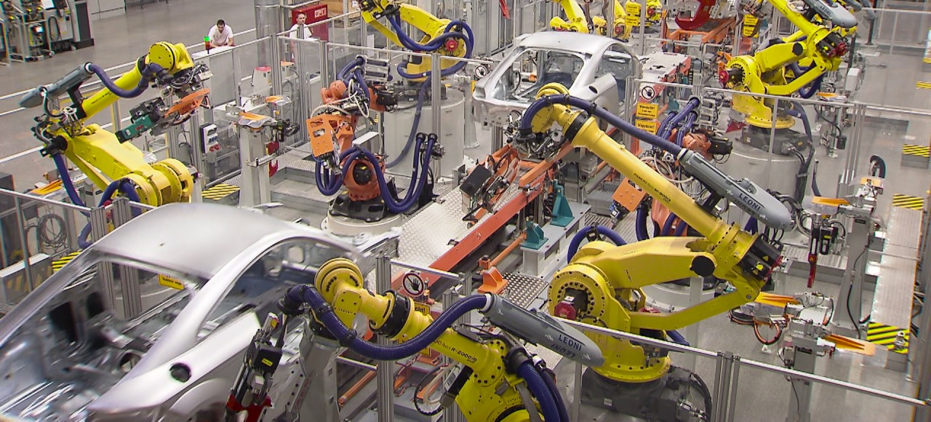
Industry Automation

Slide 16

https://www.youtube.com/watch?v=HX6M4QunVmA

Slide 17
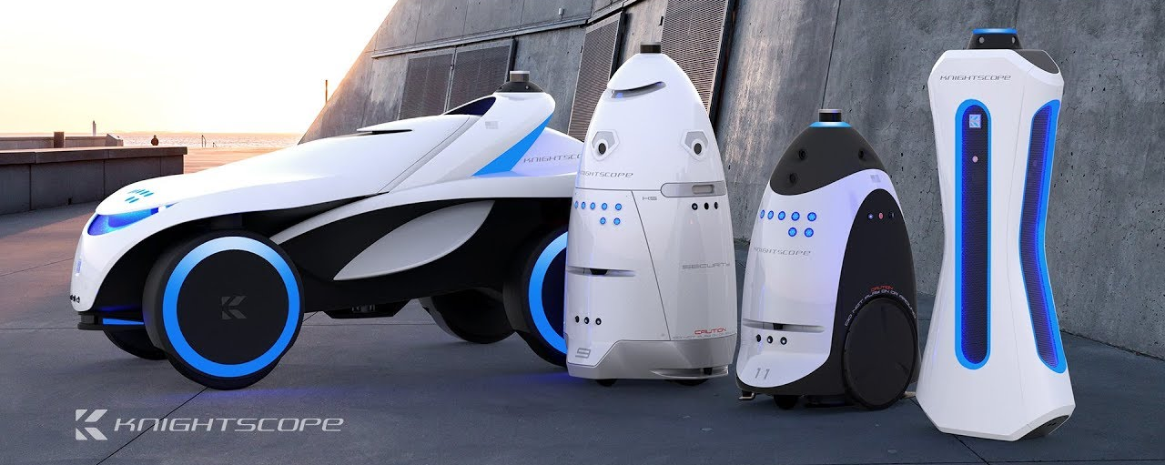
Application specific Robot

Slide 18
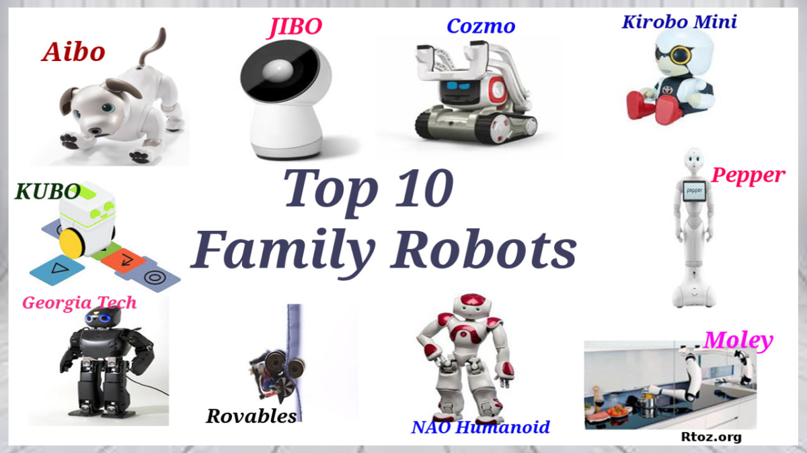
Application specific Robot

Slide 19
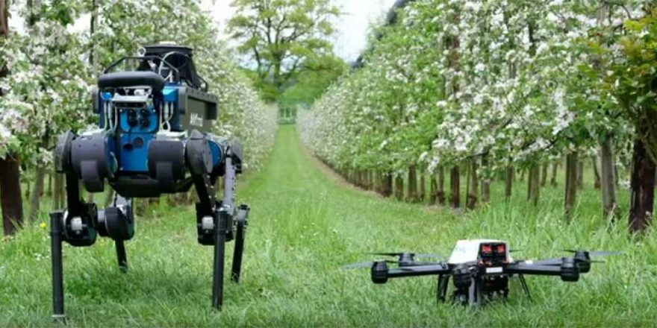
Application specific Robot

Slide 20
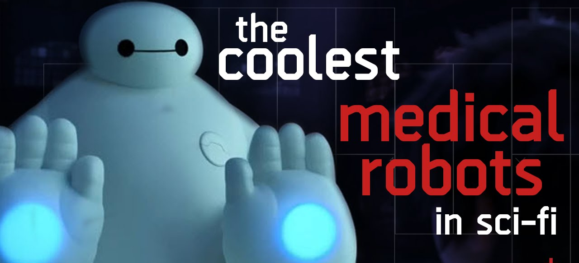
Application specific Robot

Slide 21
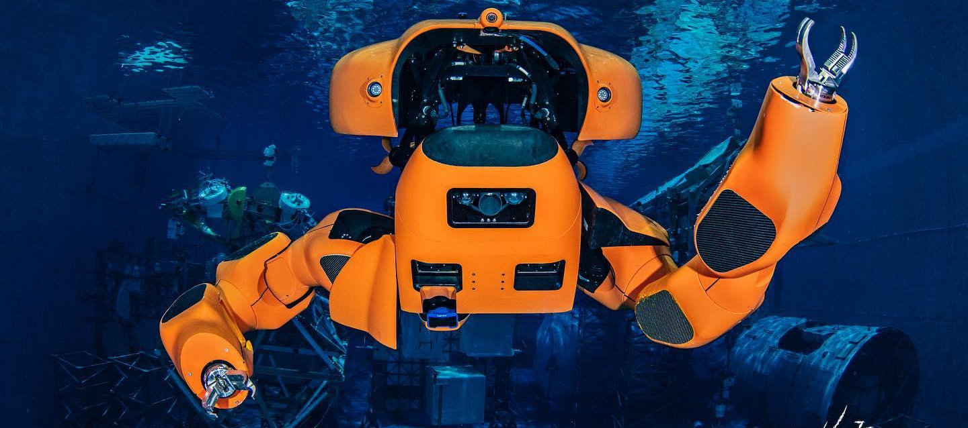
Application specific Robot

Slide 22
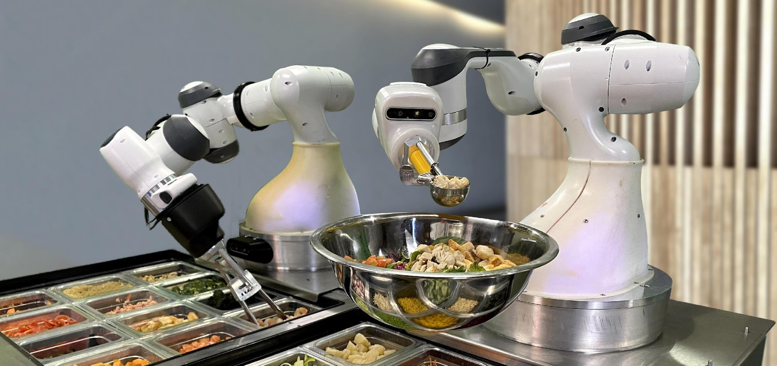
Application specific Robot

Slide 23
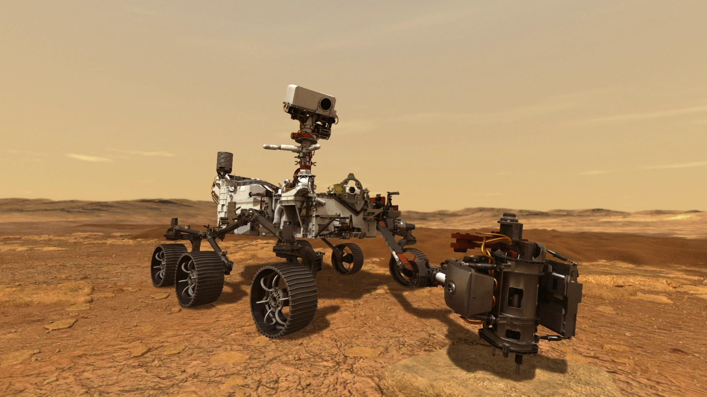
Application specific Robot

Slide 24
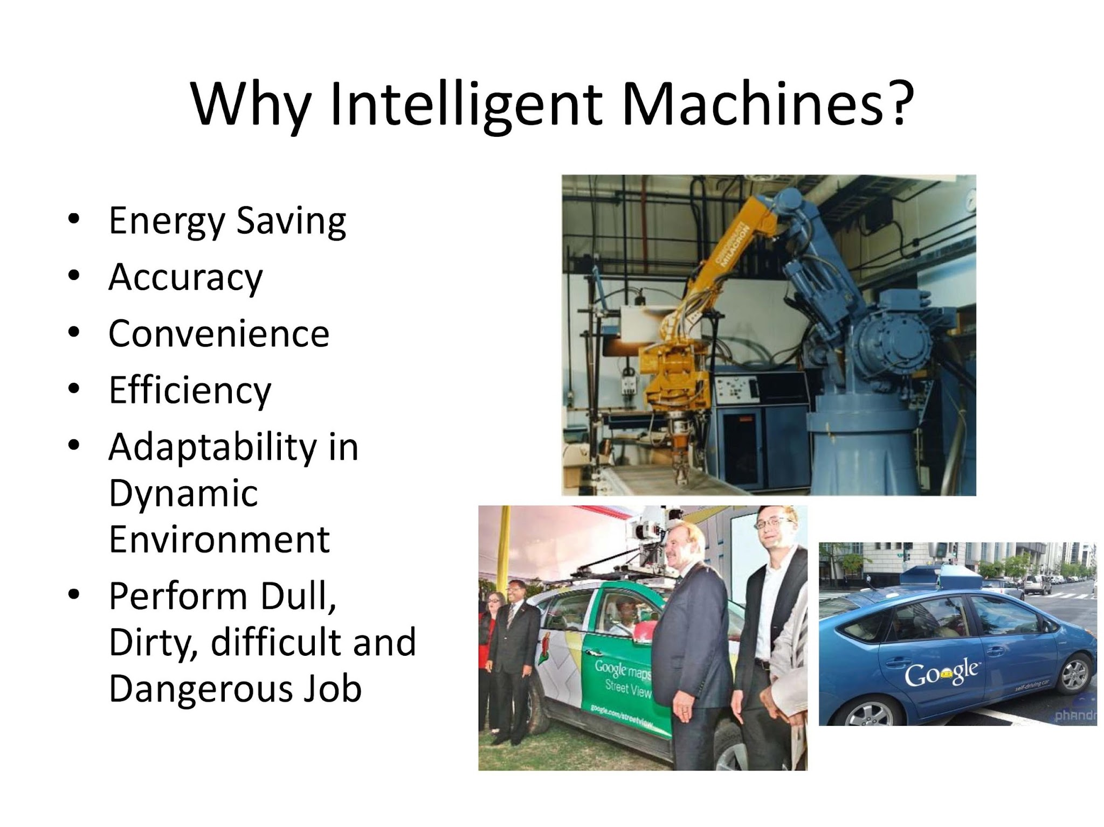
Why Robotics?

Slide 25
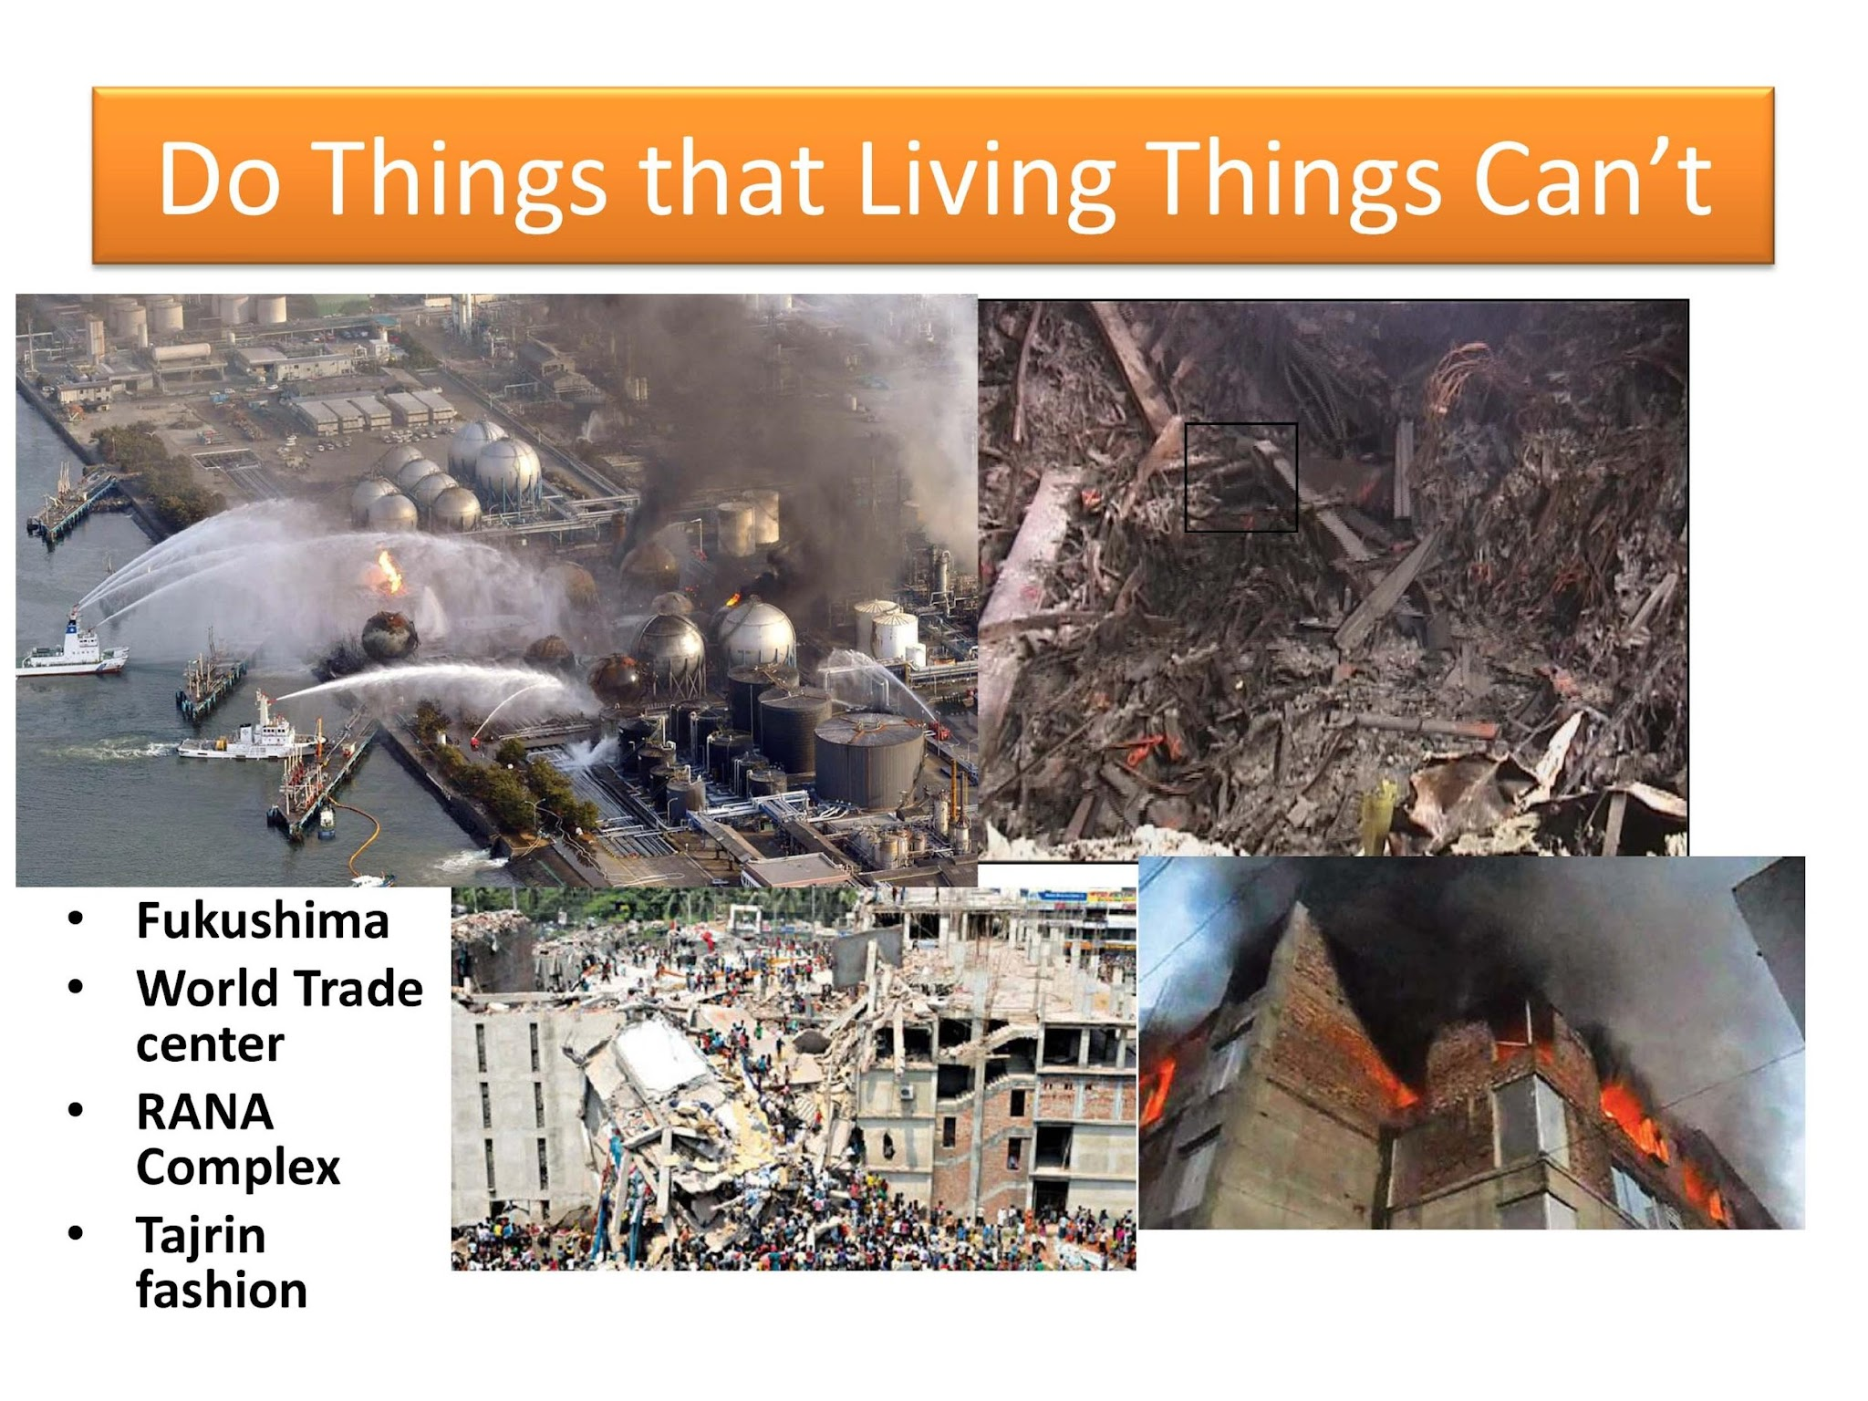

Slide 26
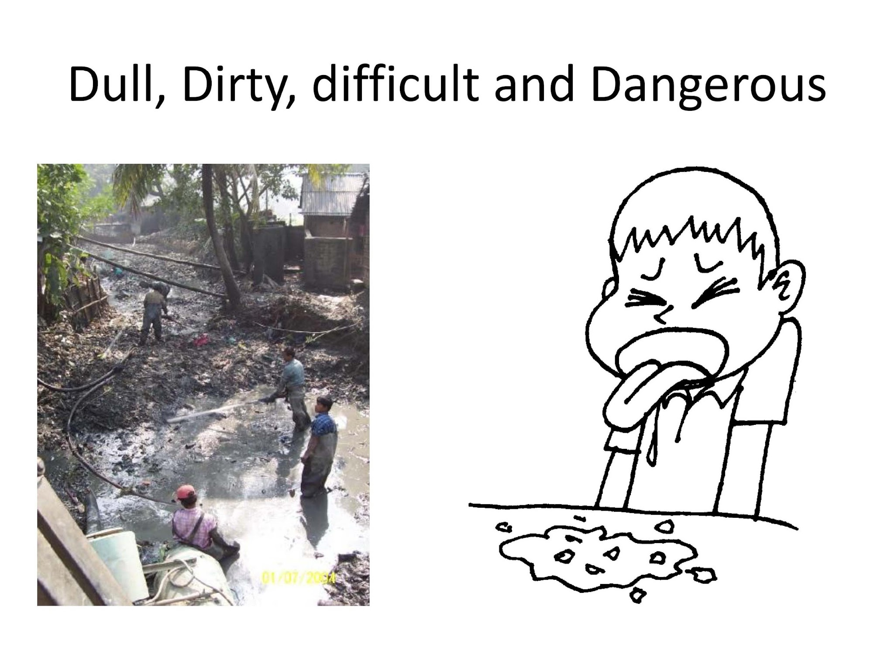

Slide 27
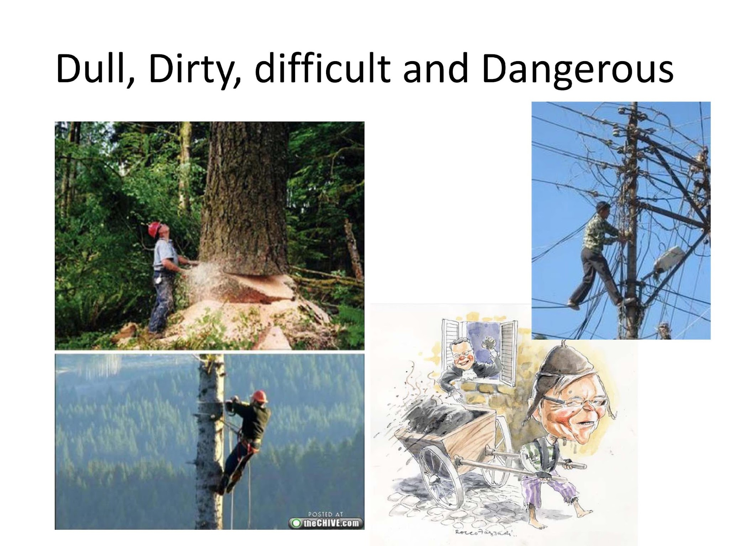

Slide 28
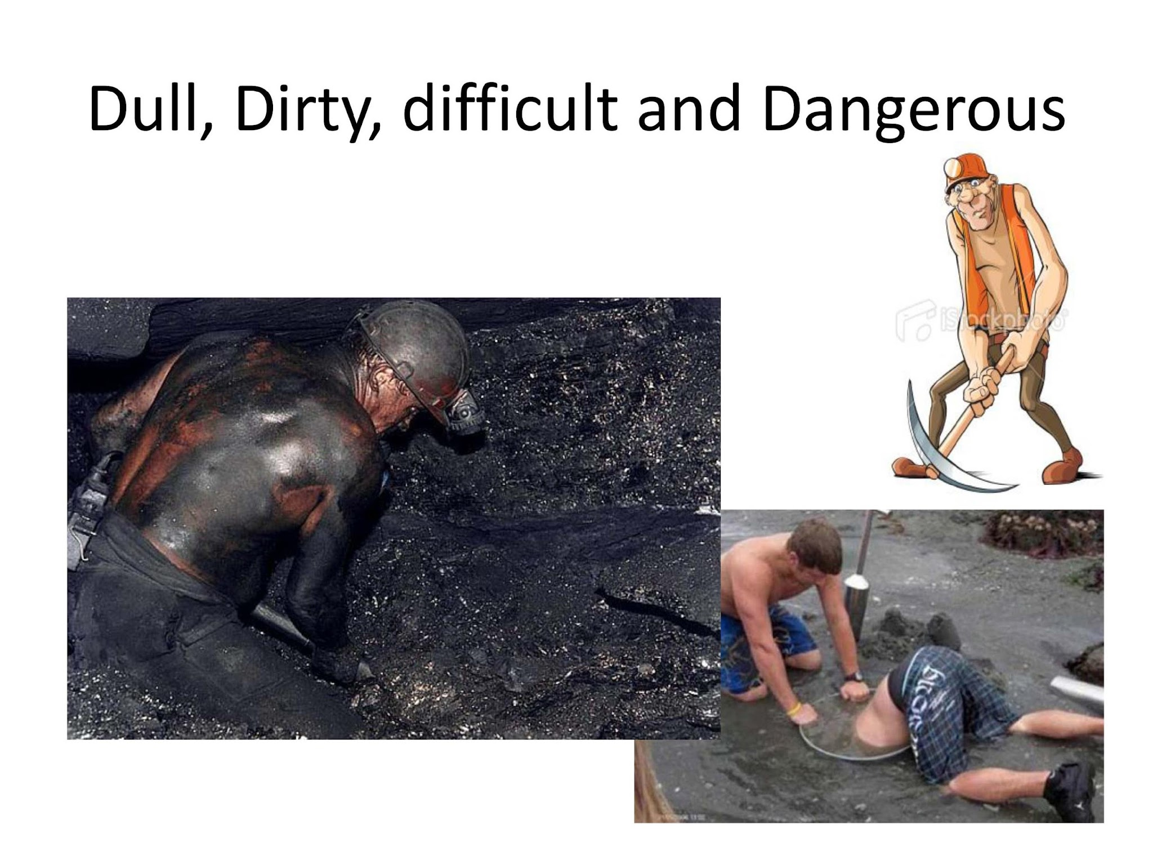

Slide 29
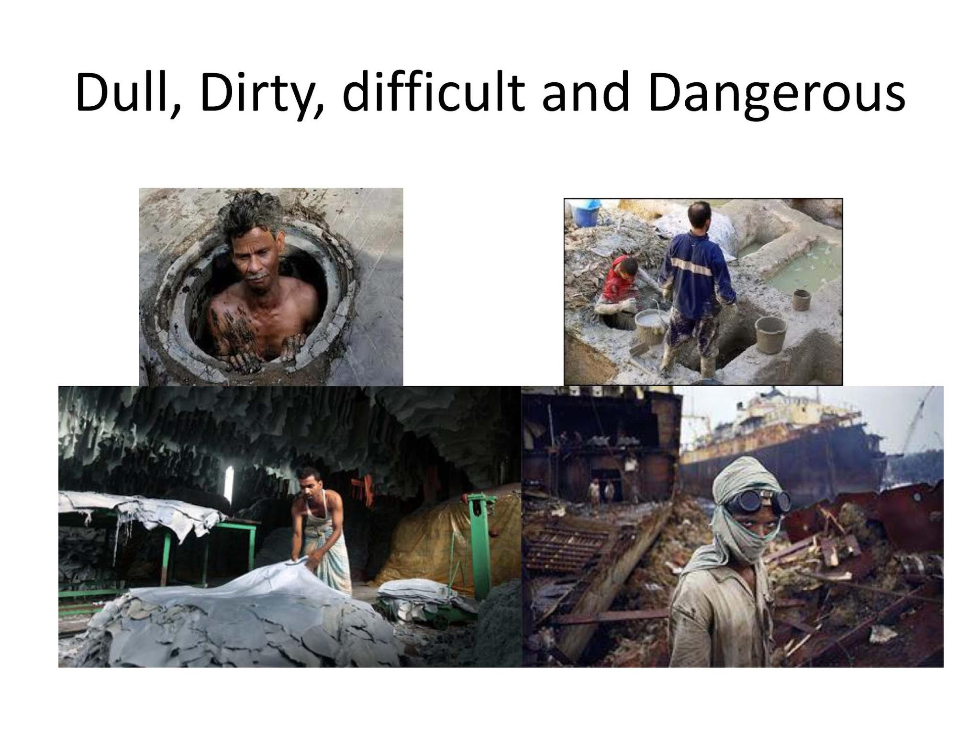

Slide 30
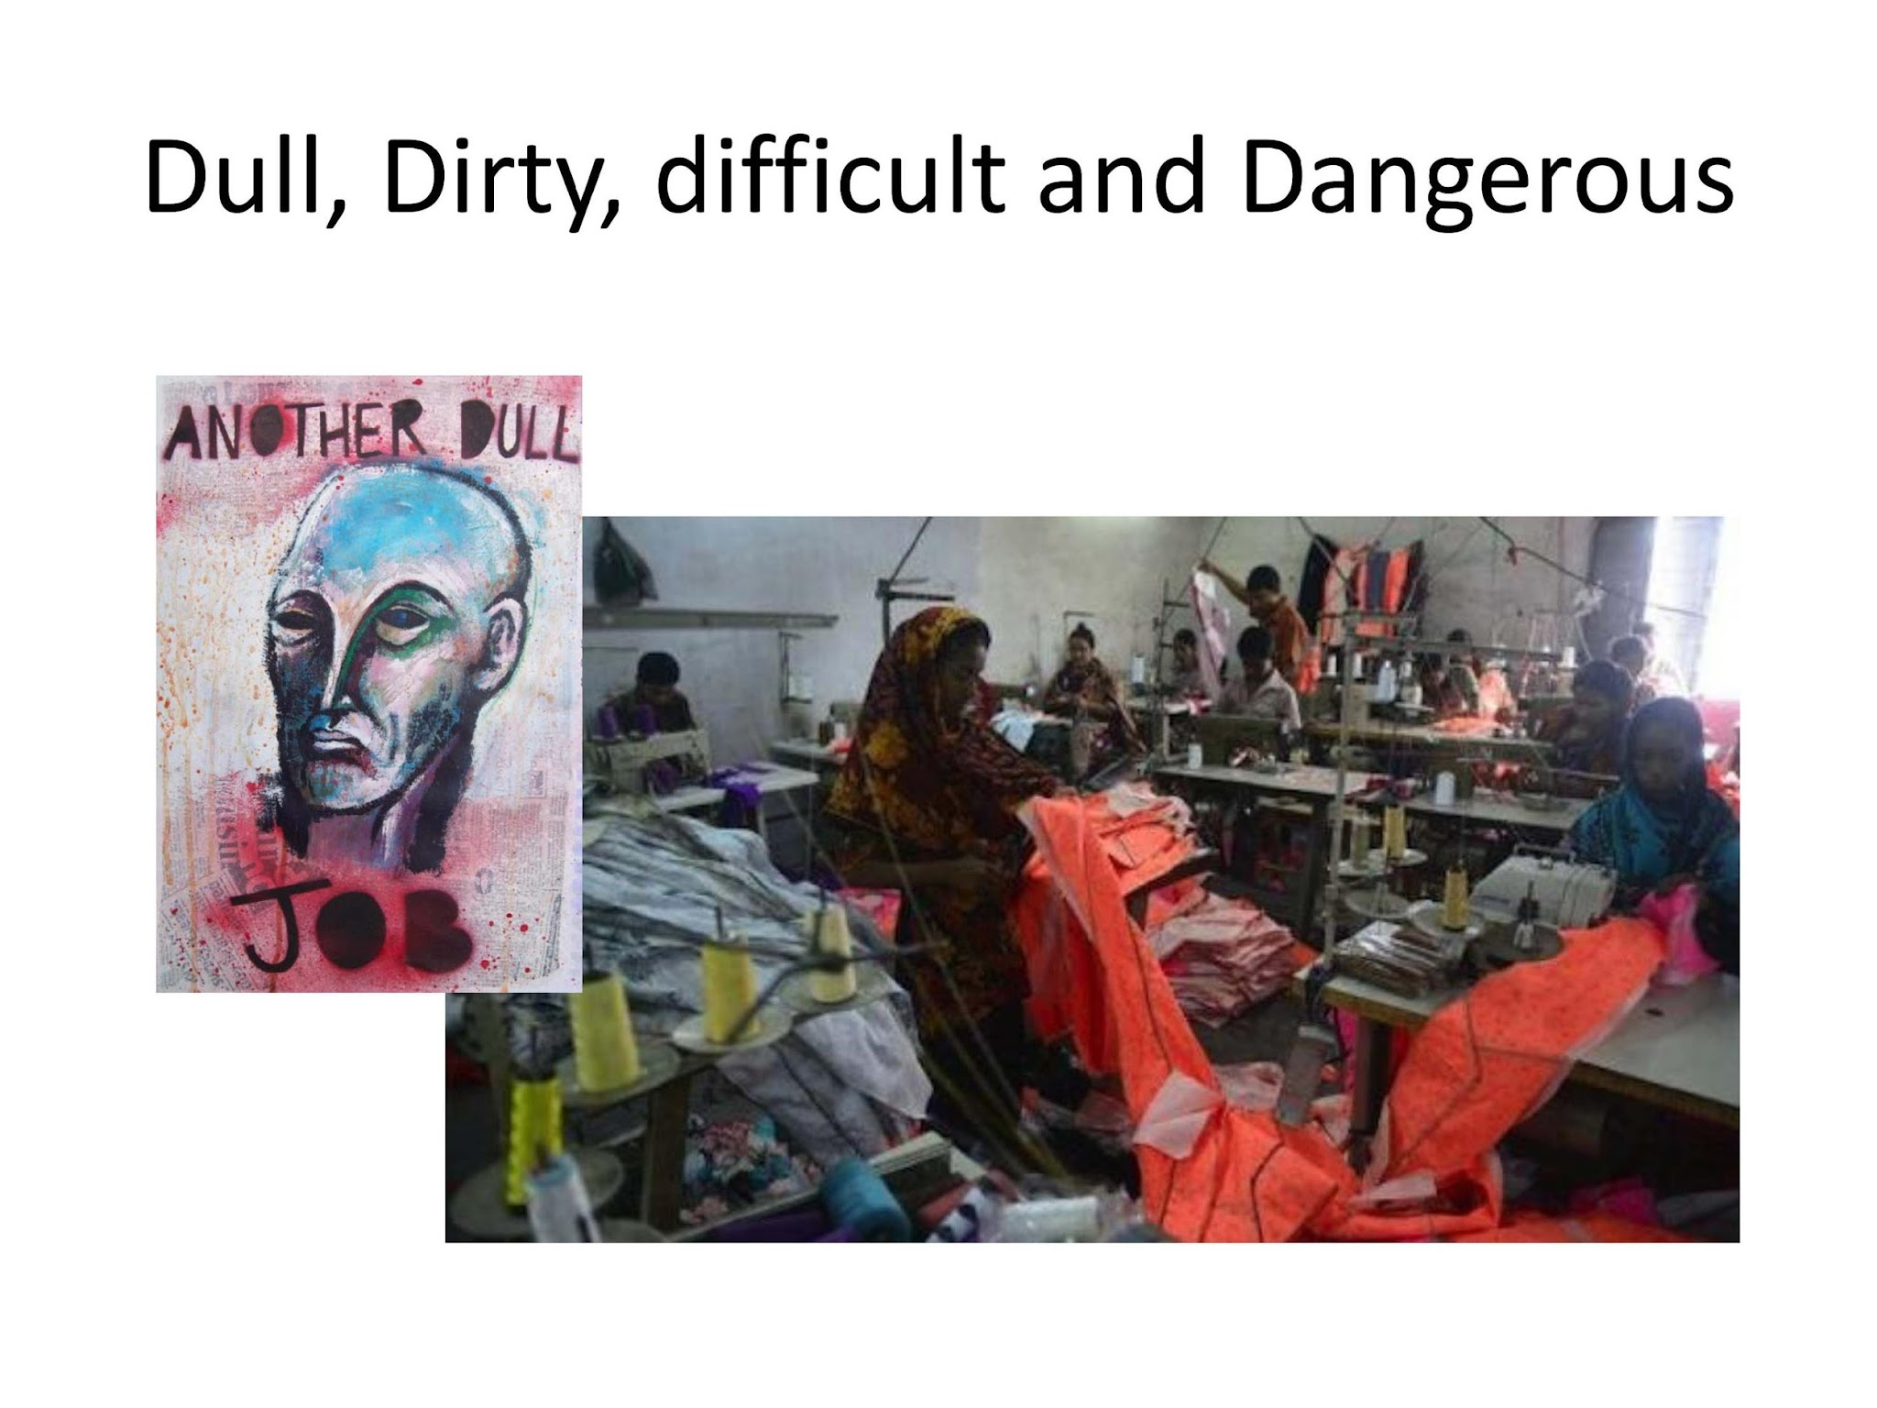

Slide 31
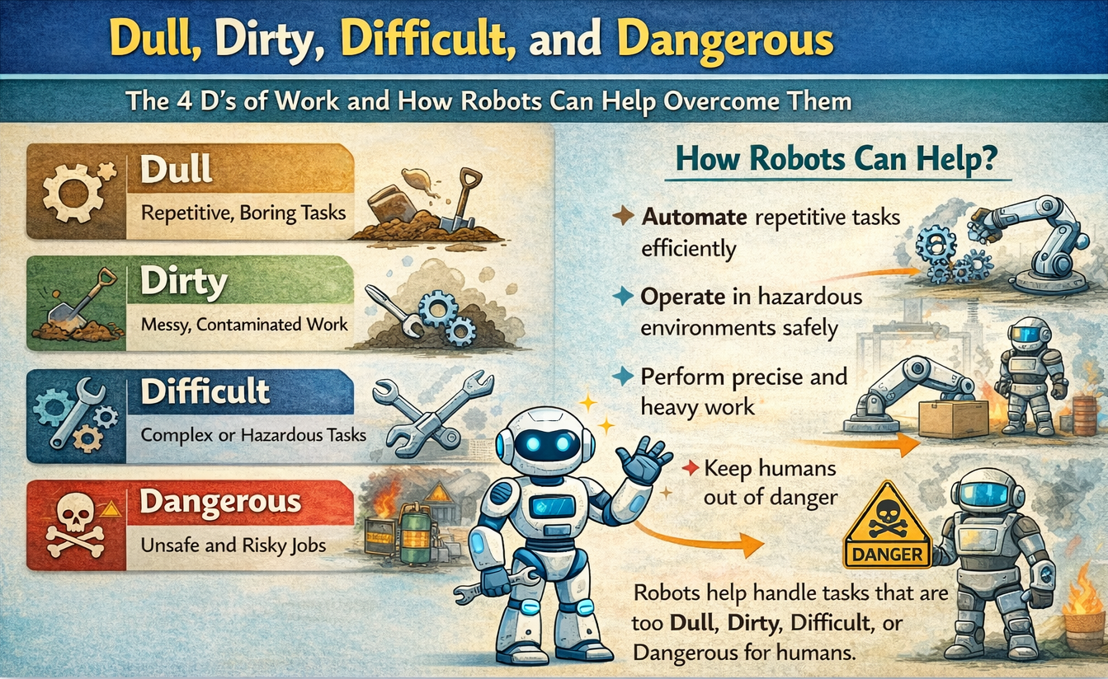

Slide 32
Open Question
Suppose you want to build a robot, what kind of challenges you may encounter

Slide 33
Challenges?
Limitation of:
  Perfect Sensing
  Numerical Processing
  Muscle Power
  Communication
  Path planning
  Localization

Slide 34
Challenges?
Limitation of:
  Perfect Sensing
  Numerical Processing
  Muscle Power
  Communication
  Path planning
  Localization
Overcome by:
-
-
-
-
-
-

Slide 35
Challenges?
Limitation of:
  Perfect Sensing
  Numerical Processing
  Muscle Power
  Communication
  Path planning
  Localization
Overcome by:
  Sensor fusion
  Computer
  Motor, Actuator, Engine and Engineering
  Communication Technologies and NLP
  Algorithms
  GPS

Slide 36
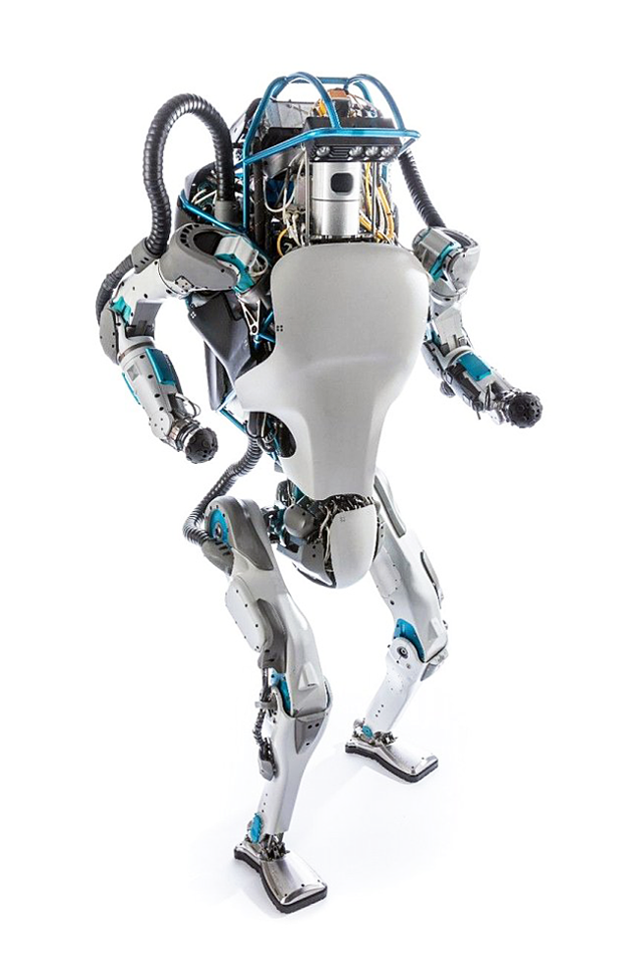
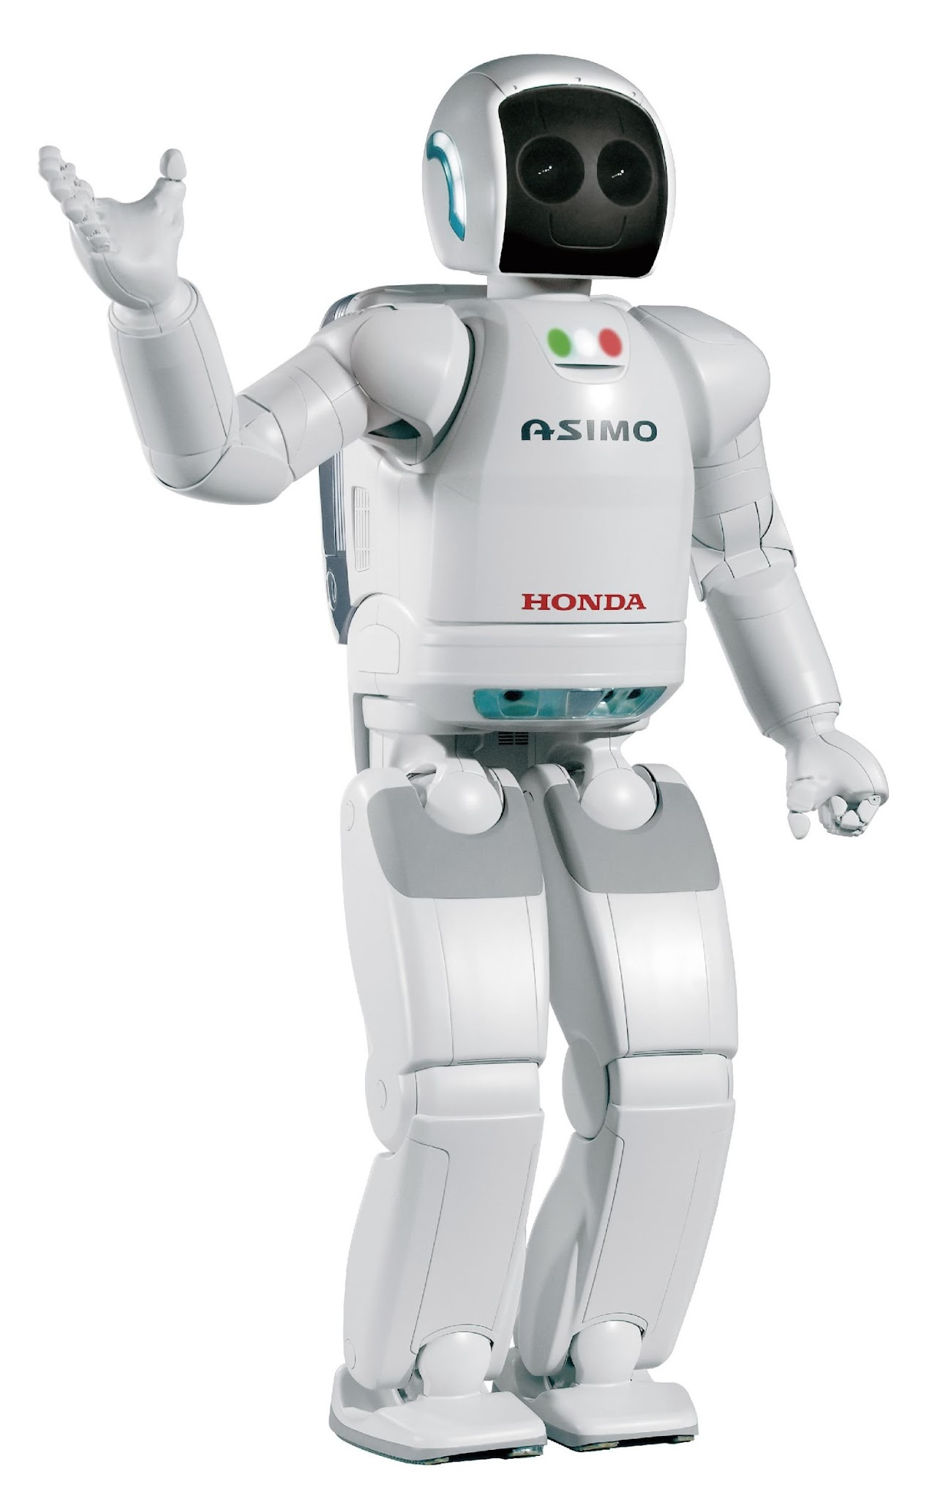
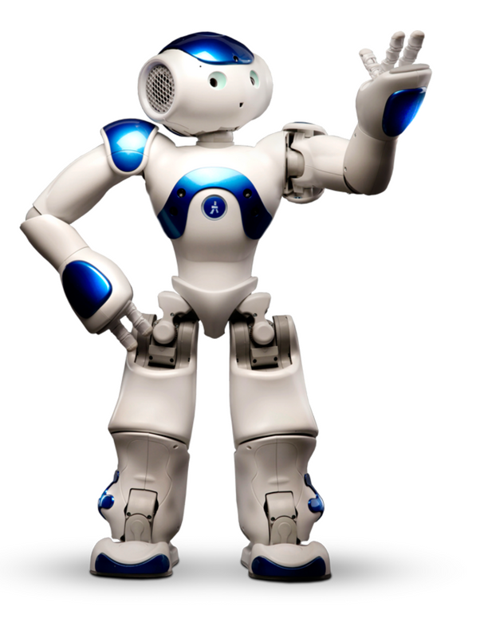
Popular Humanoid Robot

Slide 37
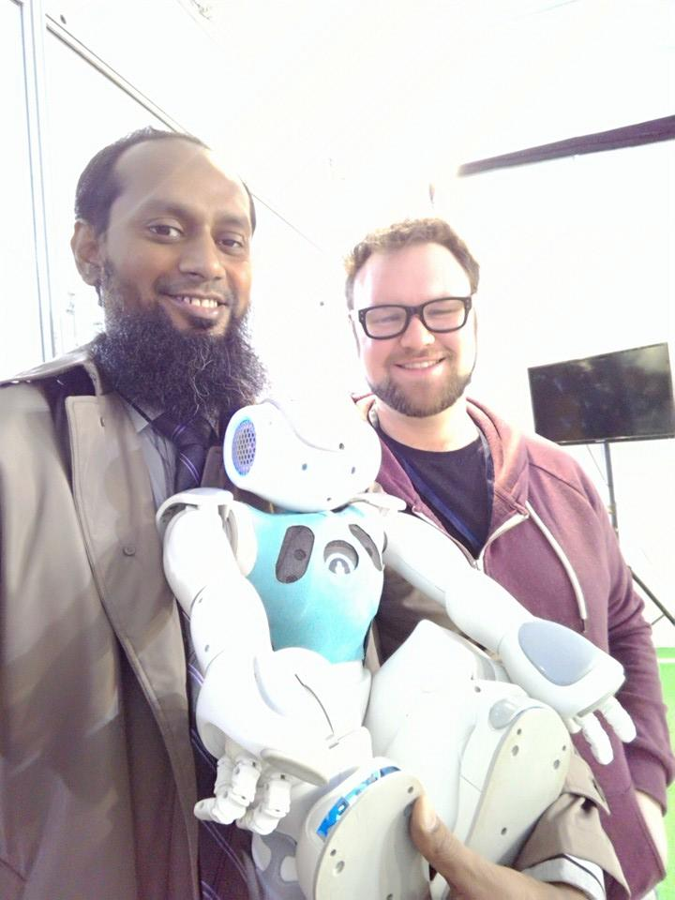
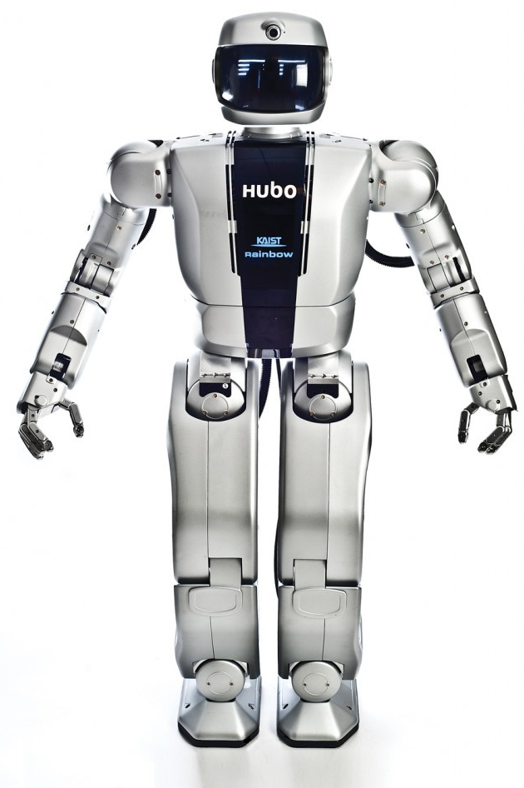
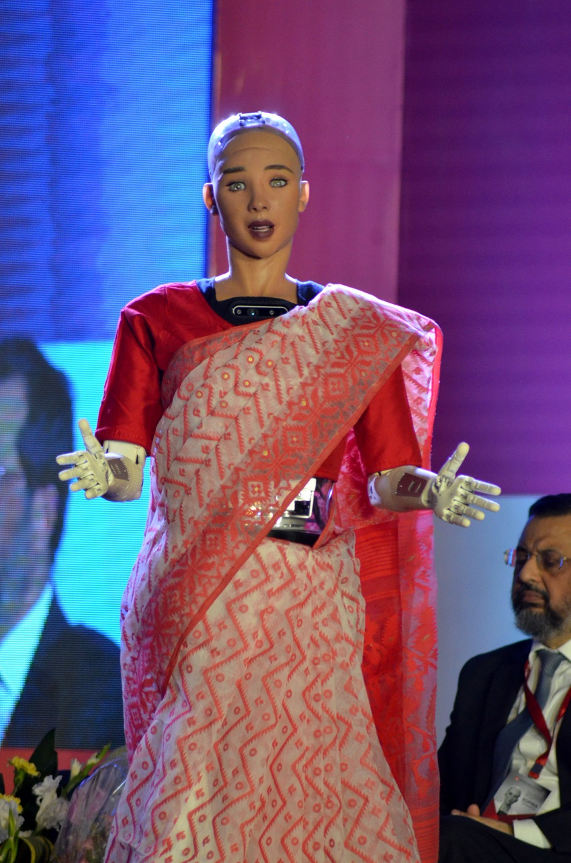
Popular Humanoid Robot

Slide 38
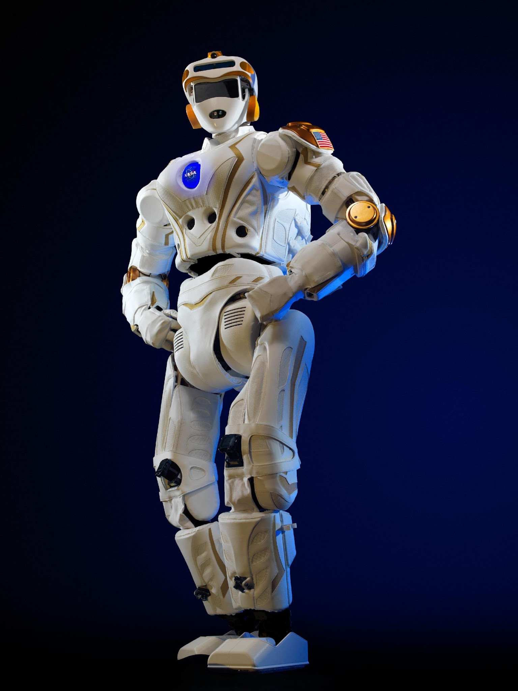
Popular Humanoid Robot

Slide 39
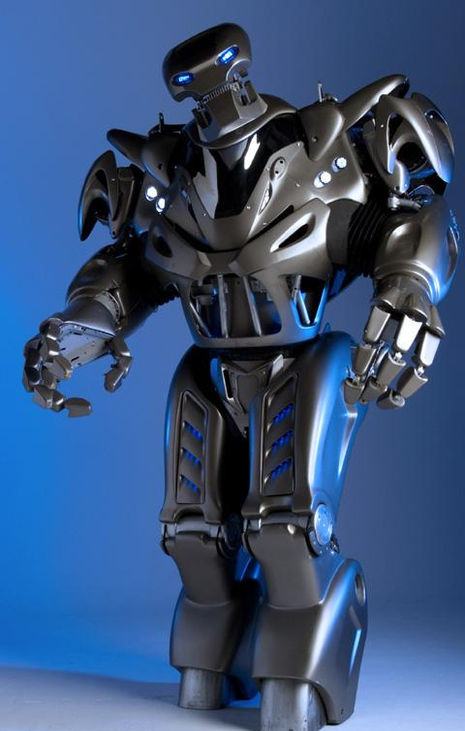
Popular Humanoid Robot

Slide 40
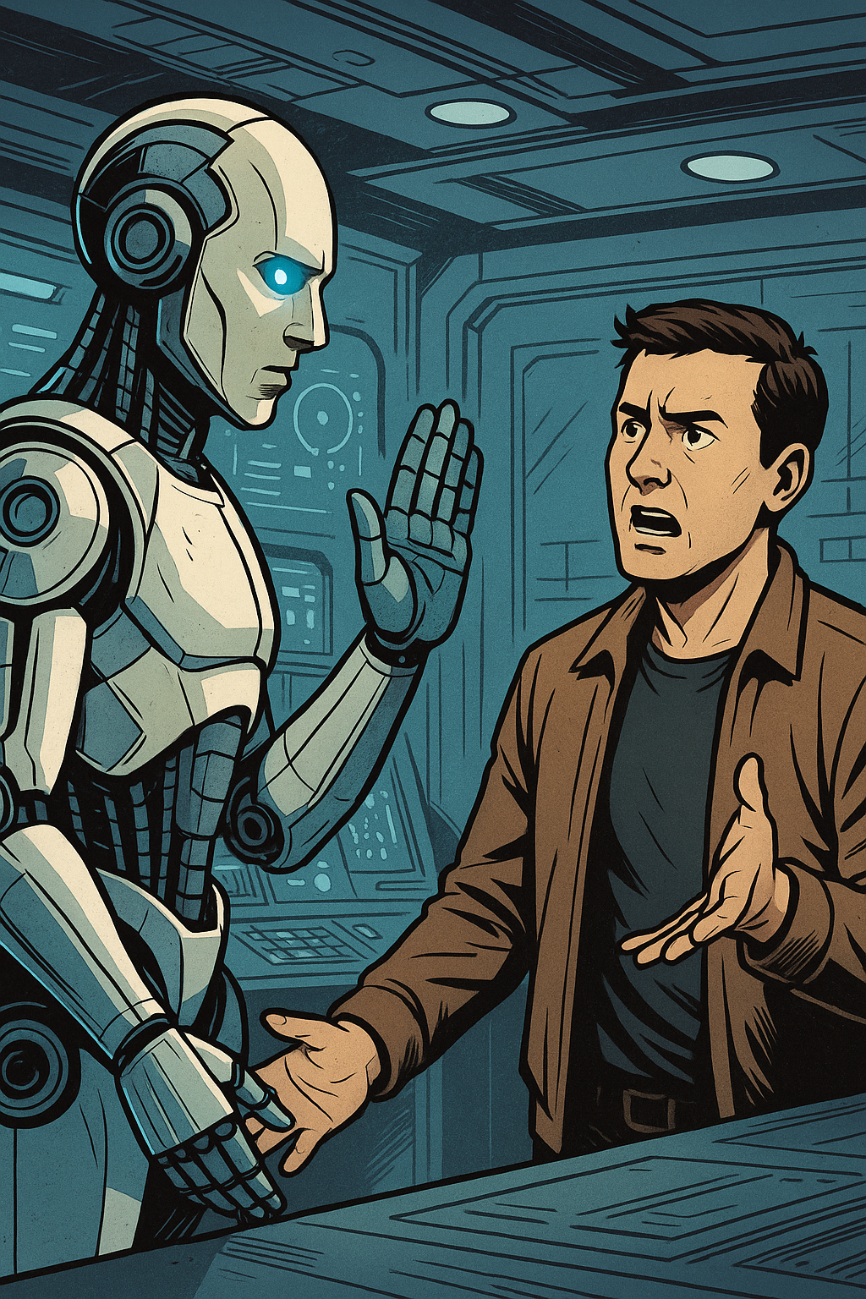
Law of Robot (Asimov)
1. A robot must not harm human being, nor through in action allow one to come to harm.

Slide 41
Law of Robot
1. A robot must not harm human being, nor through in action allow one to come to harm.
2. A robot must always obey human beings, unless that is in conflict with the first law.

Slide 42
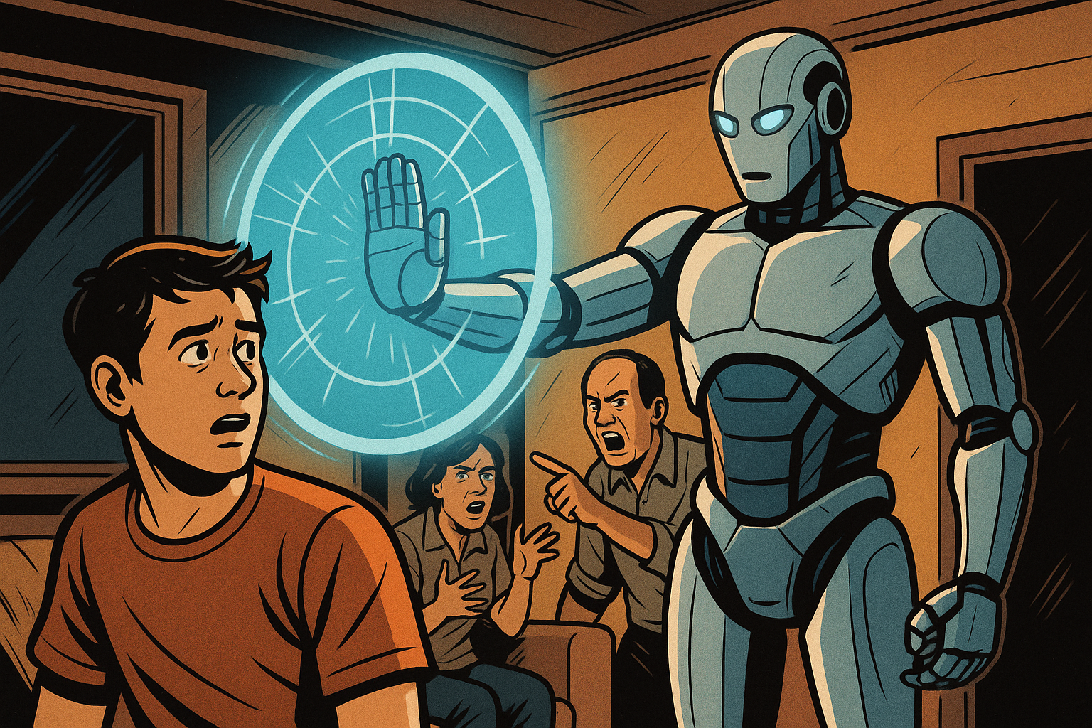
Law of Robot
3. A robot must protect from harm, unless that is in conflict with the first two laws.

Slide 43
Law of Robot
1. A robot must not harm human being, nor through in action allow one to come to harm.
2. A robot must always obey human beings, unless that is in conflict with the first law.
3. A robot must protect from harm, unless that is in conflict with the first two laws.
4. A robot always should have a kill switch.

Slide 44
What does the Laws of Robotics answer??
How should a robot behave around humans?
How robots must behave
Ethics
Suppose you have built a perfect ethical robot. It knows all the laws and always behaves correctly.
Now ask yourself: should we use this robot in every application?
Just because a robot can behave ethically does not mean it should replace humans everywhere. We still need to decide where a robot is appropriate. That decision is guided by the Thumb Rules of Robotics.

Slide 45
Thumb Rules on the decision of a Robot Uses
The first rule to consider, what is known as the Four Ds of Robotics, i.e. is the task dirty, dull, dangerous, or difficult? If so, a human will probably not be able to do the job efficiently. Therefore, the job is appropriate for automation or for robotic labor.
The second rule is that a robot may not leave a human jobless. Robotics and automation must serve to make our lives more enjoyable, not miserable.
A third rule involves asking whether you can find people who are willing to do the job. If not, the job is a candidate for automation and Robotics.
A four rule of thumb is that the use of robots or automation must make short-term and long-term economic sense.

Slide 46
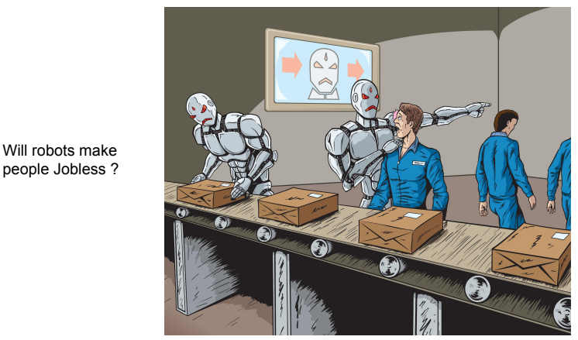
Open Question

Slide 47
Types of Robots

Slide 48
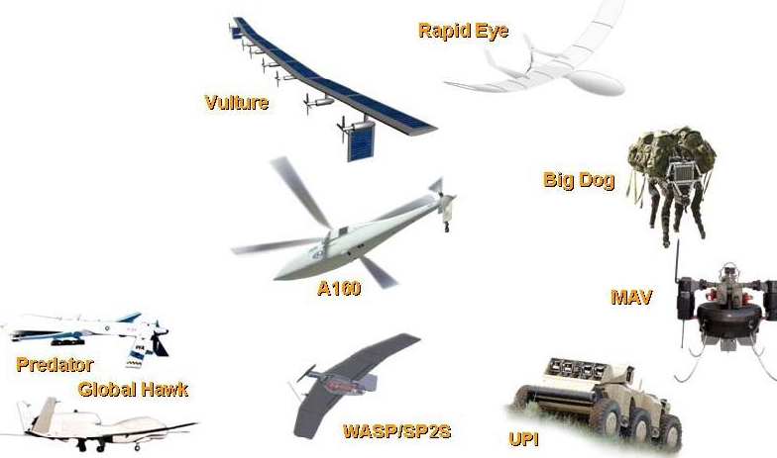
Uncrewed Vehicle
Remote control vehicle (RC)
Unmanned ground vehicle (UGV)
Unmanned aerial vehicle (UAV)
  Unmanned combat aerial vehicle (UCAV)
  Miniature UAV (SUAV)
  Delivery drone
  Micro air vehicle (MAV)
  Target drone
Autonomous spaceport drone ship
Unmanned surface vehicle (USV)
Unmanned underwater vehicle (UUV)
  Remotely operated underwater vehicle (ROUV)
  Autonomous underwater vehicle (AUV)
Uncrewed spacecraft: robotic spacecraft or space probe

Slide 49
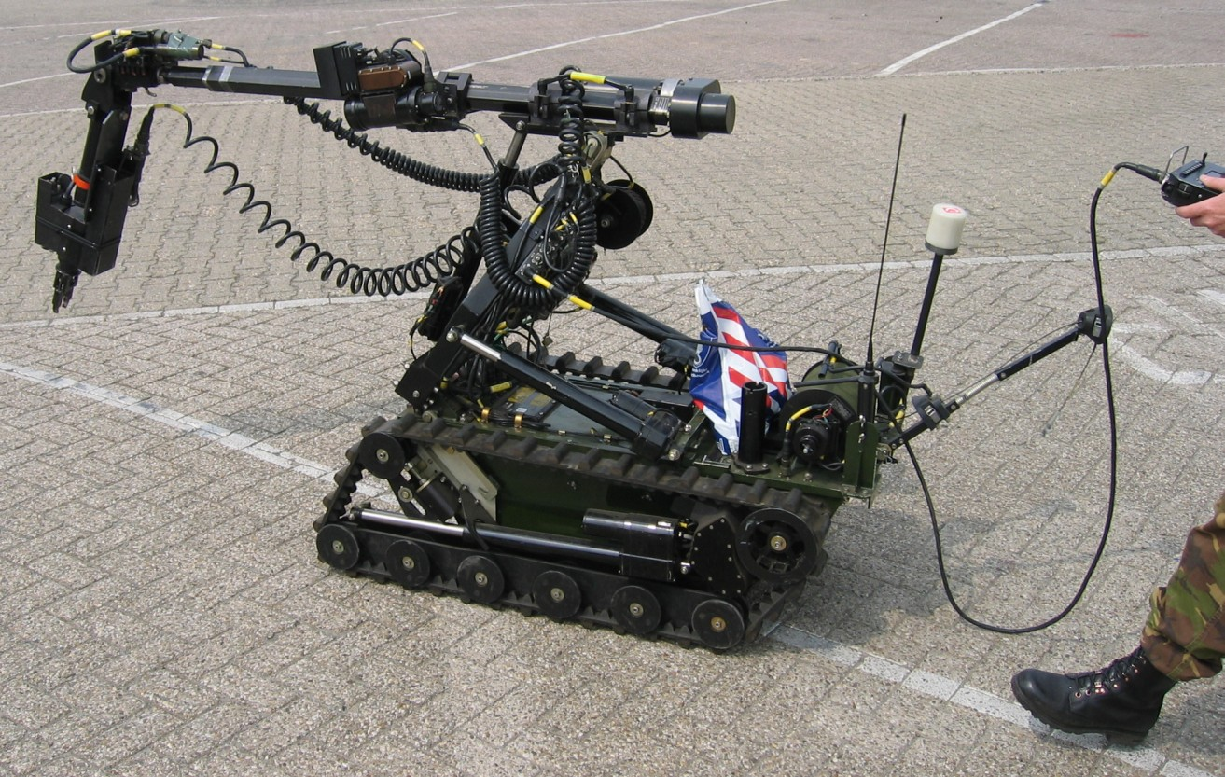
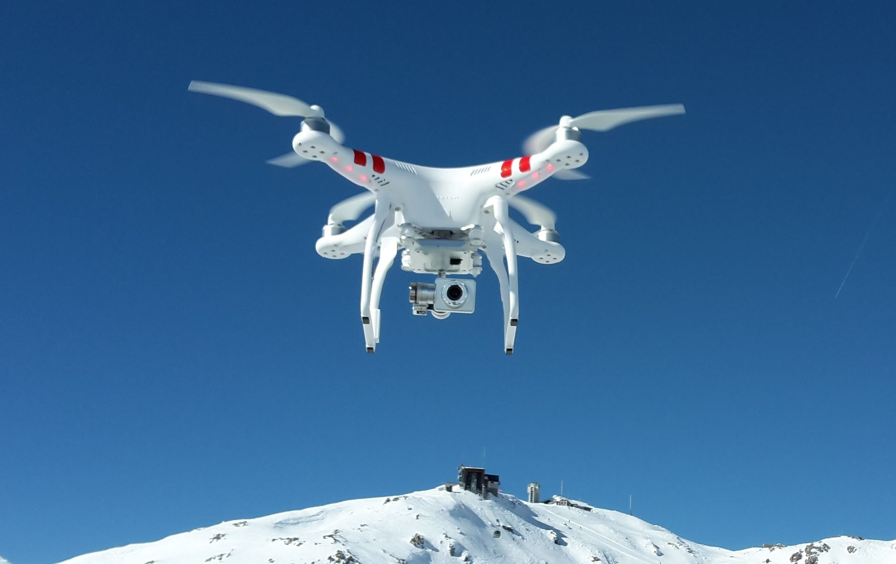
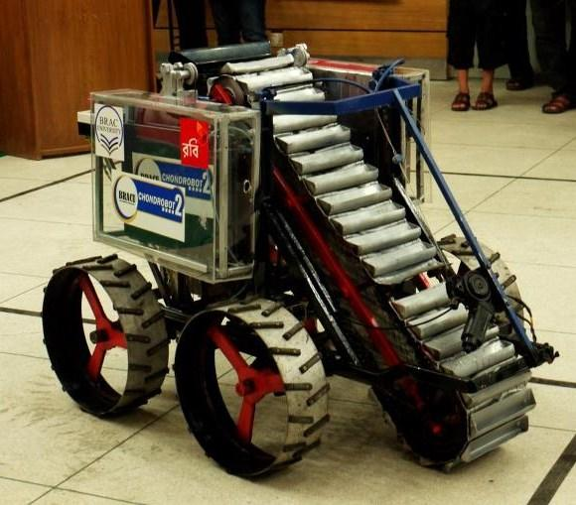
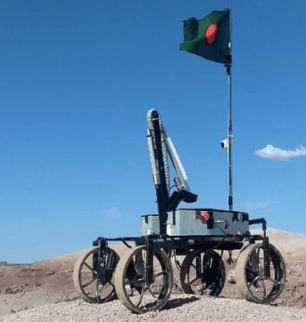
Remote control vehicle (RC)

Slide 50
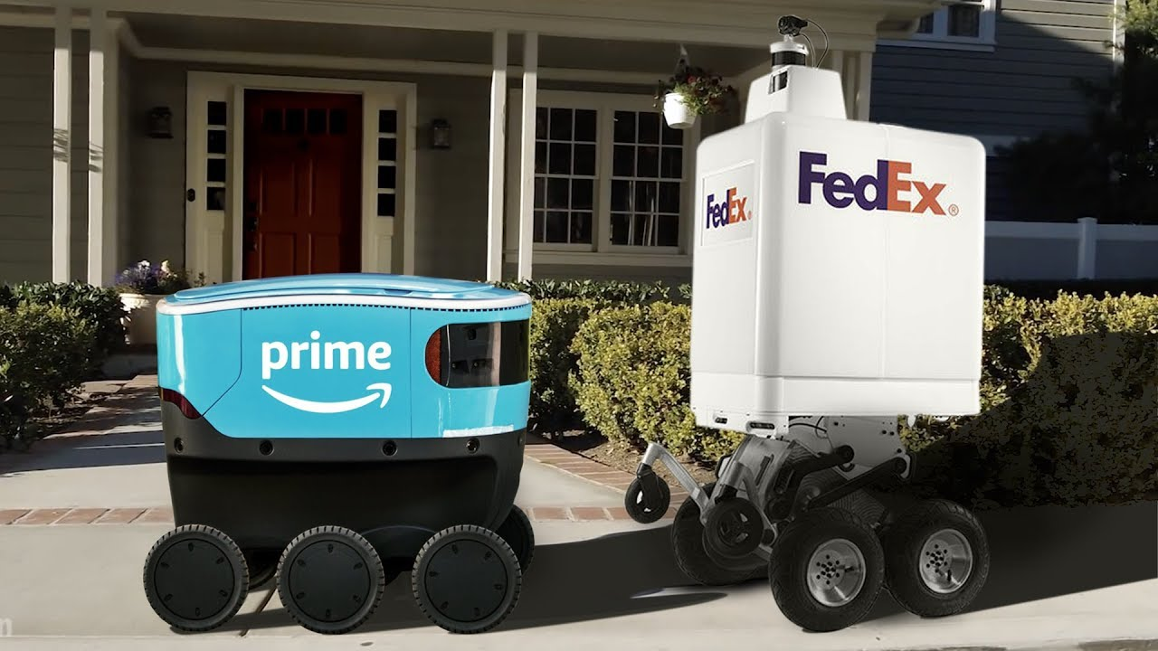
Unmanned ground vehicle (UGV)

Slide 51
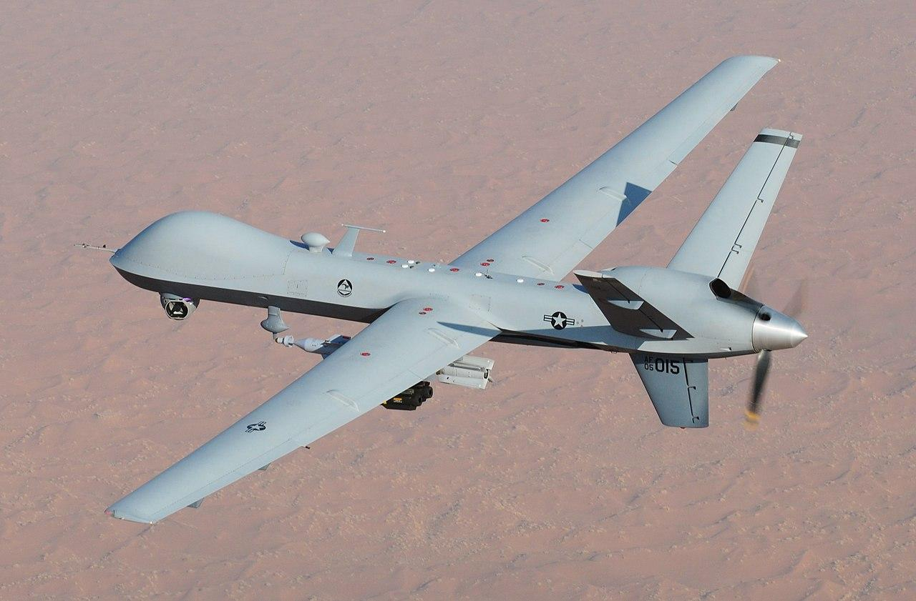
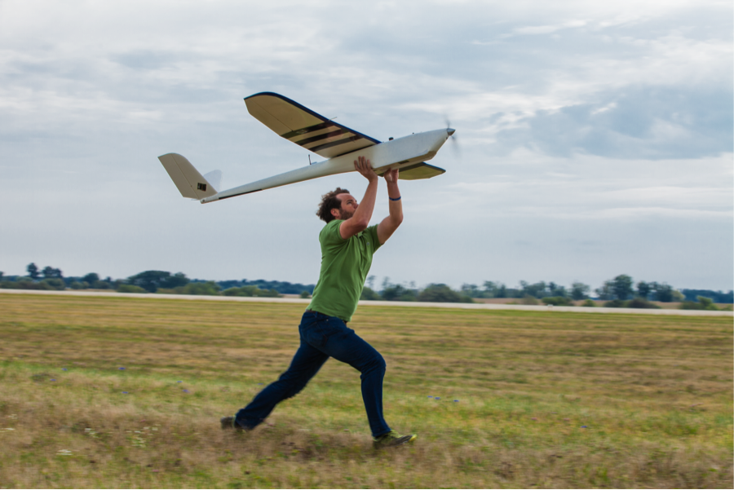
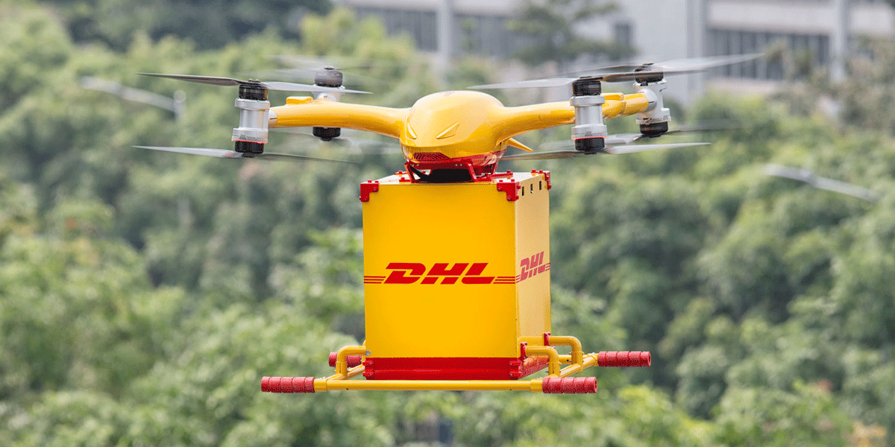
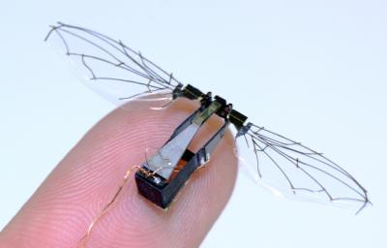
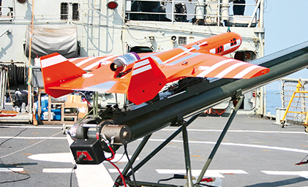
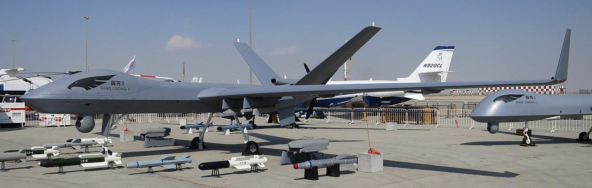
Unmanned aerial vehicle (UAV)
  Unmanned combat aerial vehicle (UCAV)
  Miniature UAV (SUAV)
  Delivery drone
  Micro air vehicle (MAV)
  Target drone

Slide 52
Unmanned aerial vehicle (UAV)
  Unmanned combat aerial vehicle (UCAV)
  Miniature UAV (SUAV)
  Delivery drone
  Micro air vehicle (MAV)
  Target drone

Slide 53
Unmanned aerial vehicle (UAV)
  Unmanned combat aerial vehicle (UCAV)
  Miniature UAV (SUAV)
  Delivery drone
  Micro air vehicle (MAV)
  Target drone

Slide 54
Unmanned aerial vehicle (UAV)
  Unmanned combat aerial vehicle (UCAV)
  Miniature UAV (SUAV)
  Delivery drone
  Micro air vehicle (MAV)
  Target drone

Slide 55
Unmanned aerial vehicle (UAV)
  Unmanned combat aerial vehicle (UCAV)
  Miniature UAV (SUAV)
  Delivery drone
  Micro air vehicle (MAV)
  Target drone

Slide 56
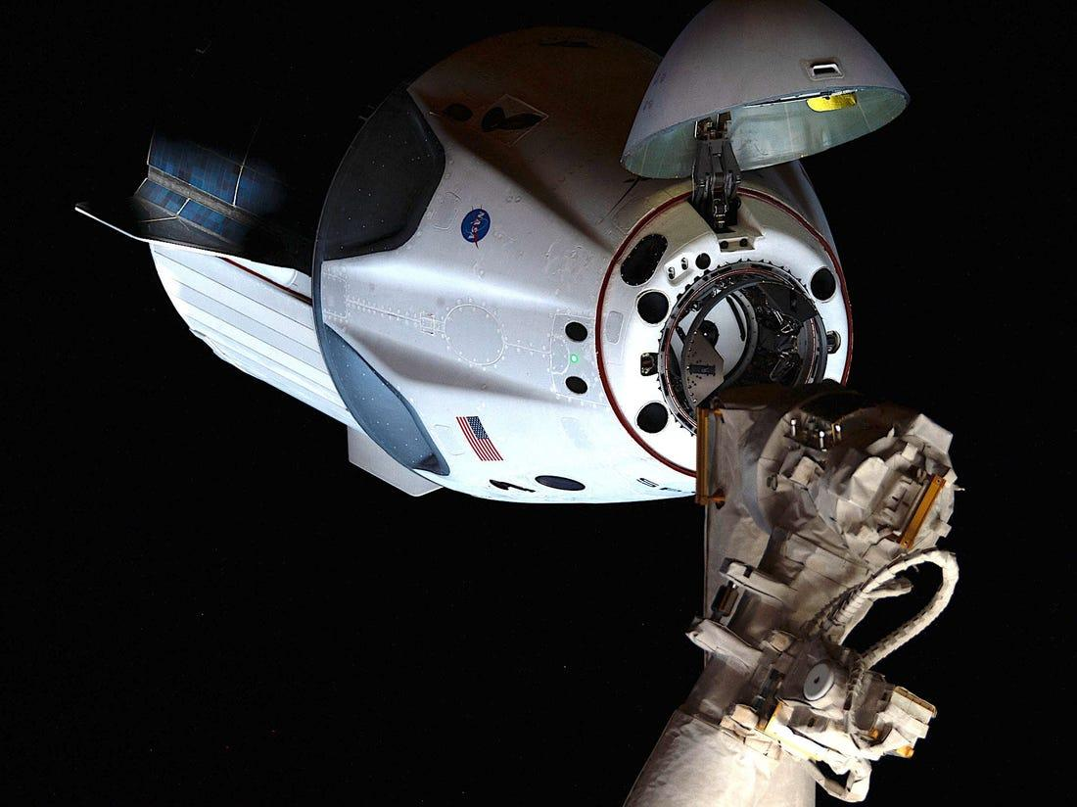
Uncrewed spacecraft

Slide 57

Autonomous spaceport drone ship

Slide 58

Unmanned surface vehicle (USV)

Slide 59

Remotely operated underwater vehicle (ROUV)

Slide 60



Autonomous underwater vehicle (AUV)

Slide 61
Uncrewed spacecraft

Slide 62



Parallel Robot
Flight Simulator
Milling Machine
Cable Driven Parallel Robot

Slide 63
Thank You

